Slide 1

MILP algorithms: branch-and-bound and branch-and-cut

Slide 2
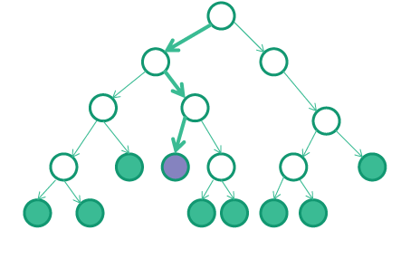
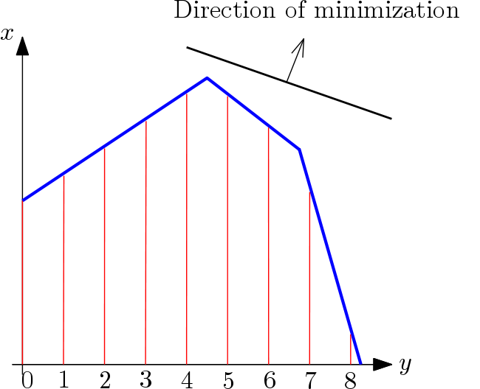
Content
The Branch-and-Bound (BB) method.
  the framework for almost all commercial software for solving mixed integer linear programs
Cutting-plane (CP) algorithms.
Branch-and-Cut (BC)
  The most efficient general-purpose algorithms for solving MILPs

Slide 3
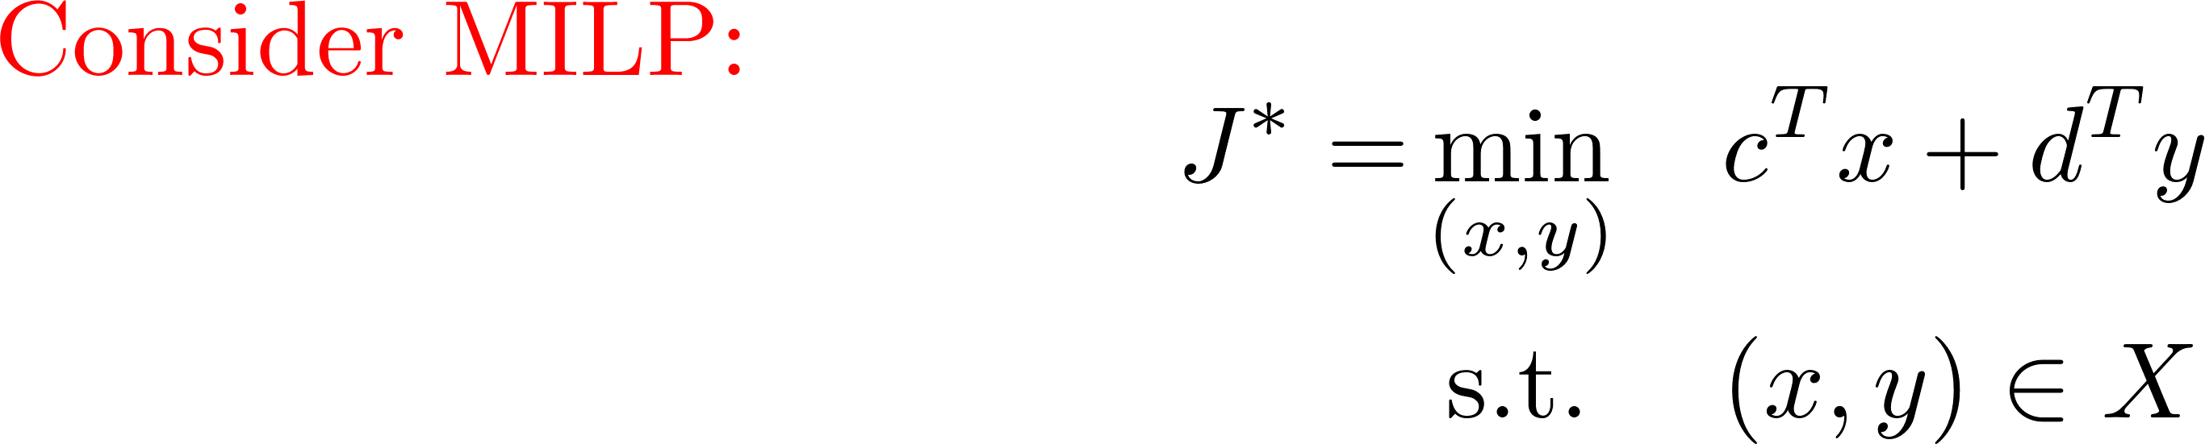
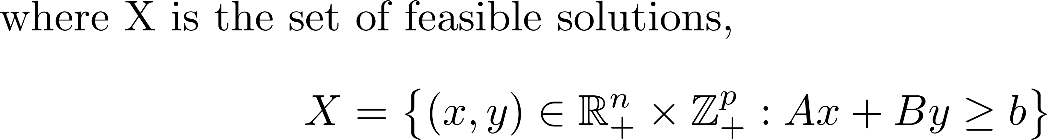
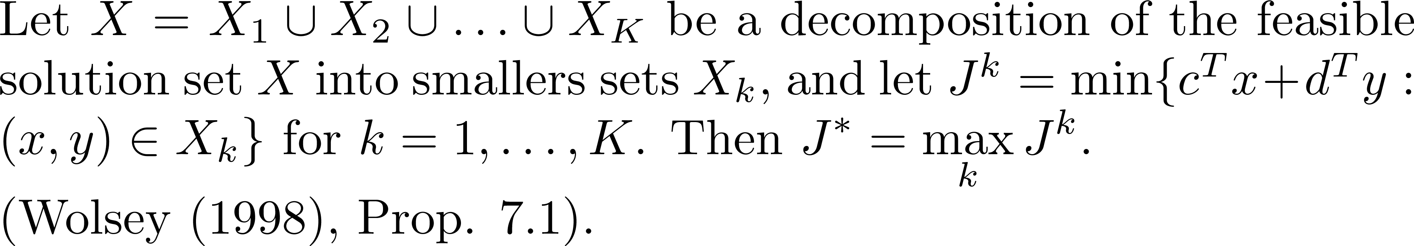
Basic idea of Branch-and-bound
BB is a divide and conquer approach: break problem into subproblems (sequence of LPs) that are easier to solve

Slide 4
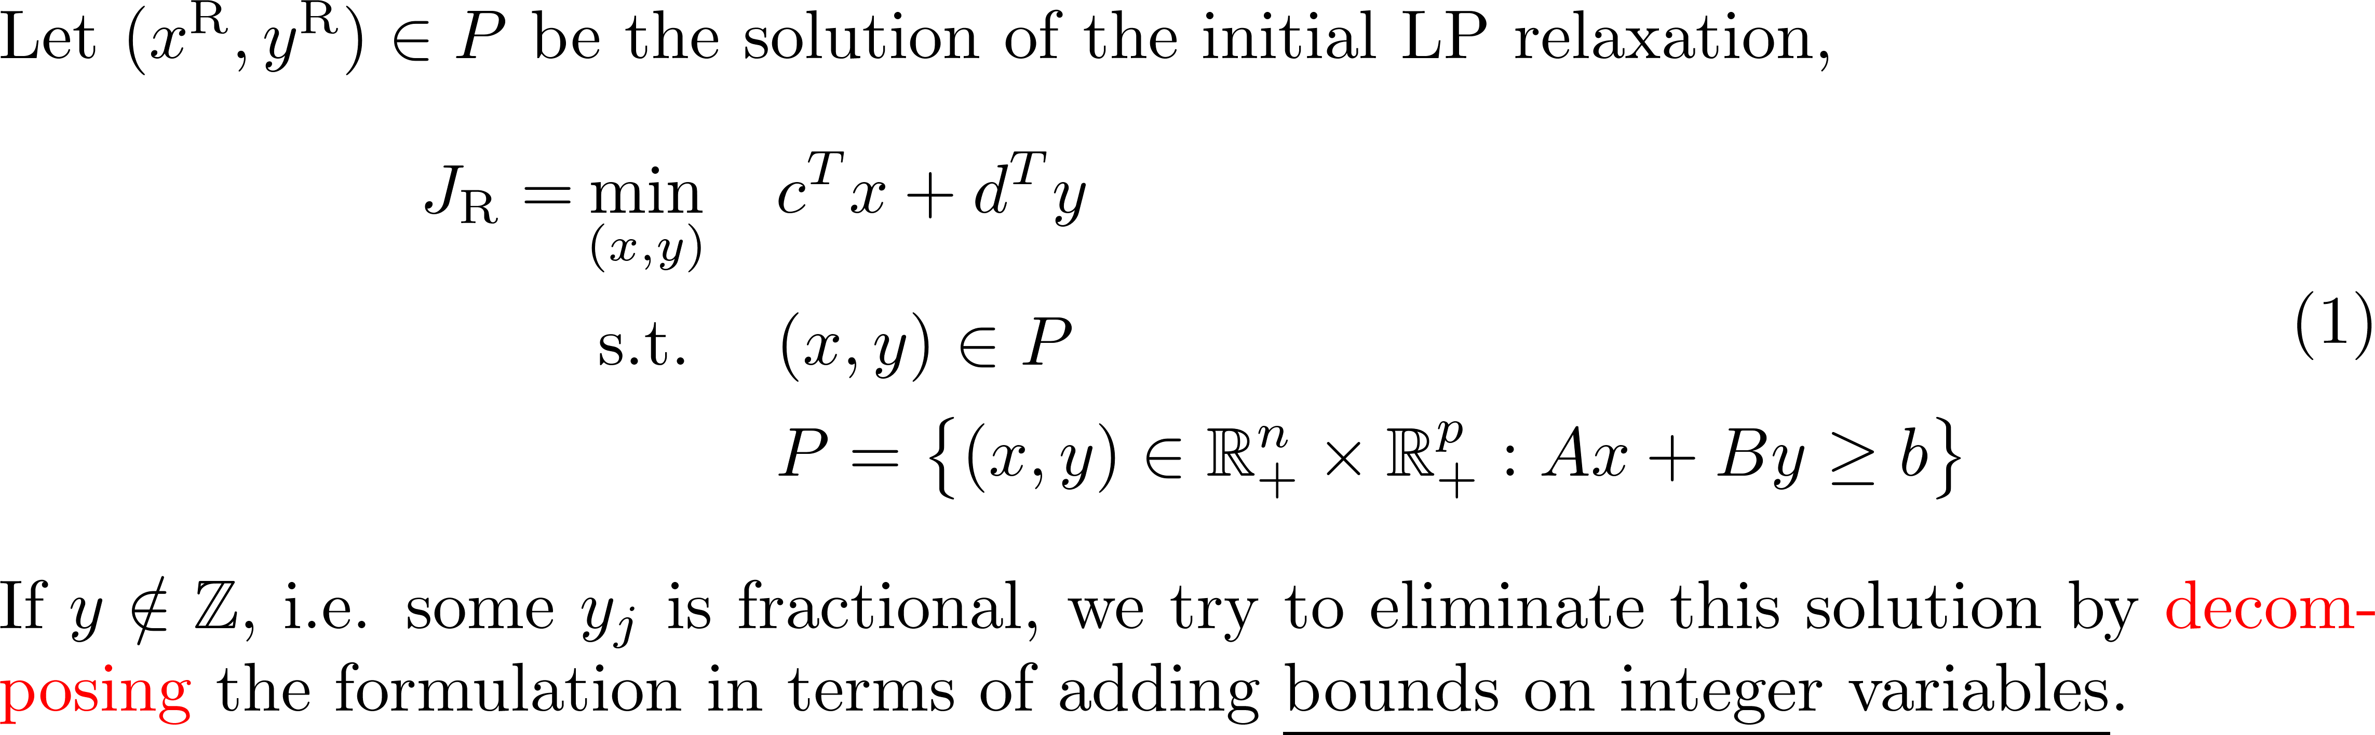
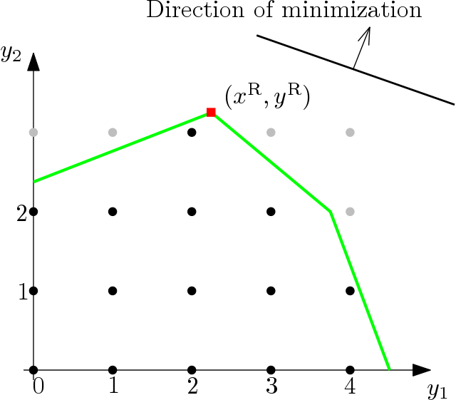
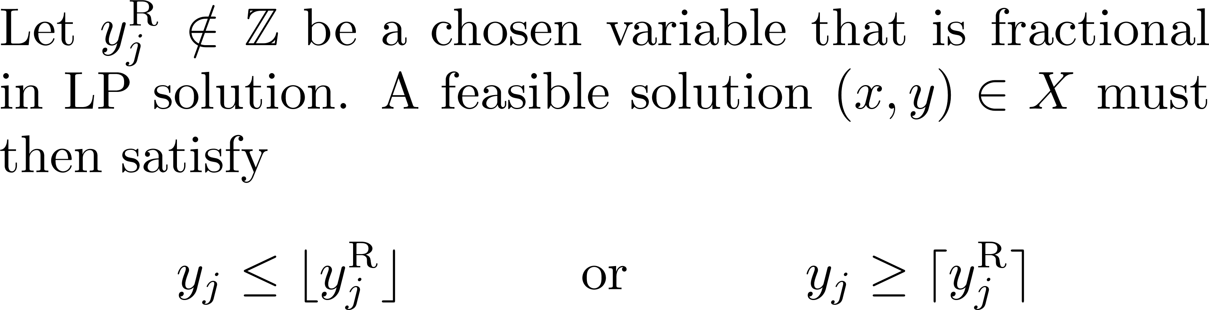
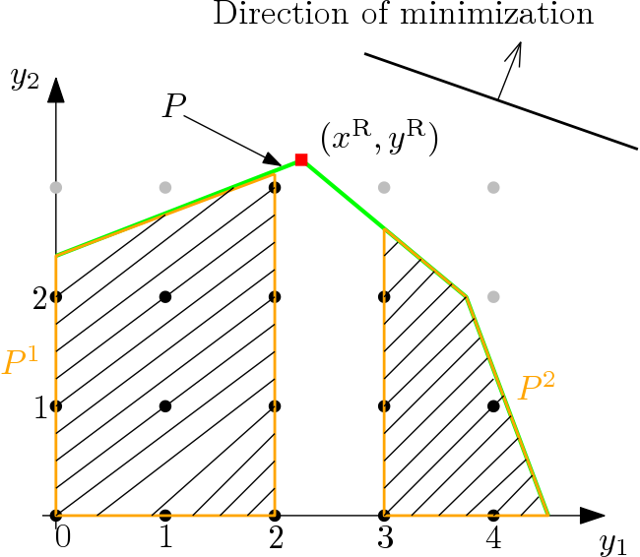
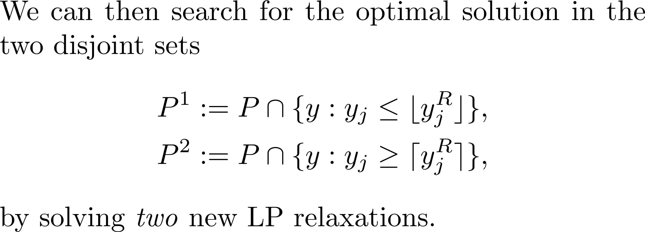
Decomposing the initial formulation P

Slide 5
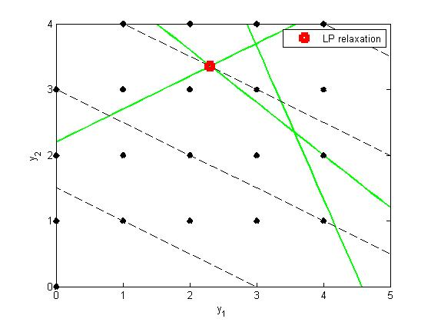
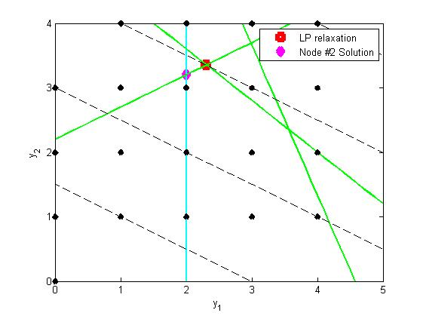
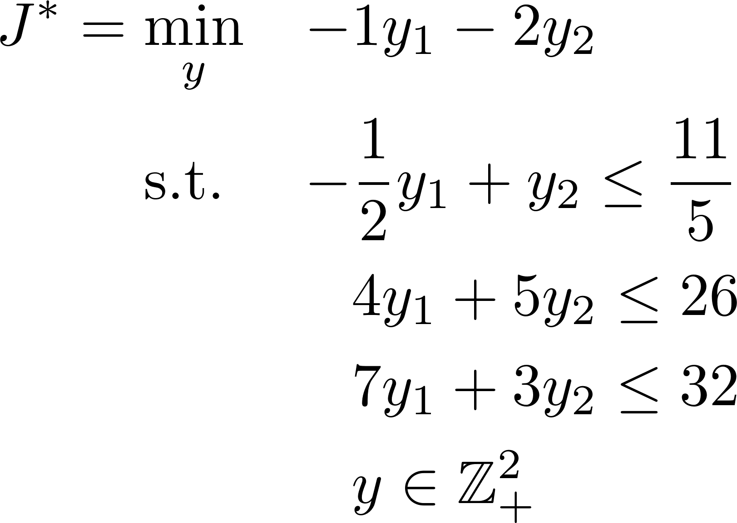

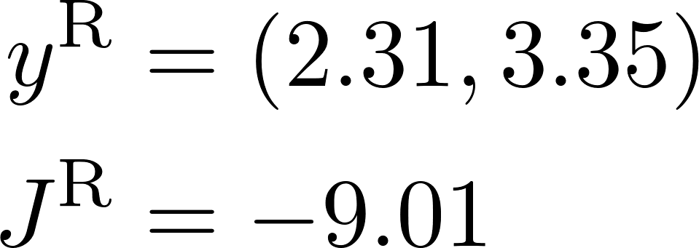

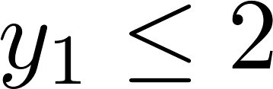
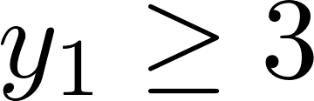

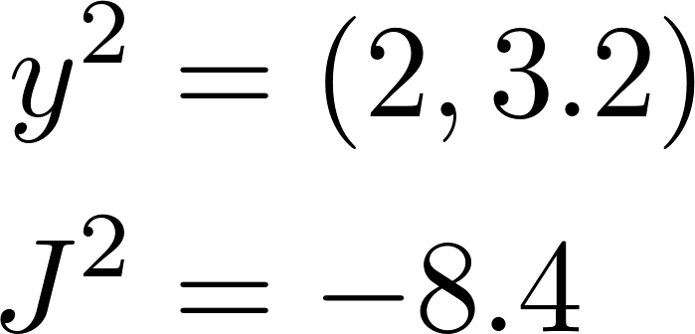

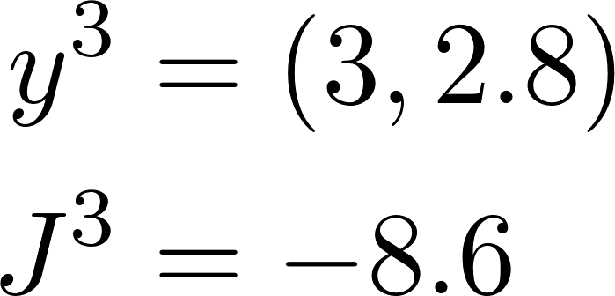
Enumeration tree
IP example 1:
s
How to proceed without
complete enumeration?
s
s

Slide 6
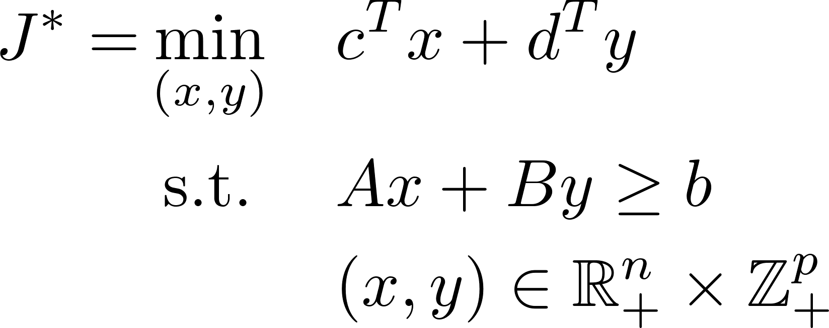
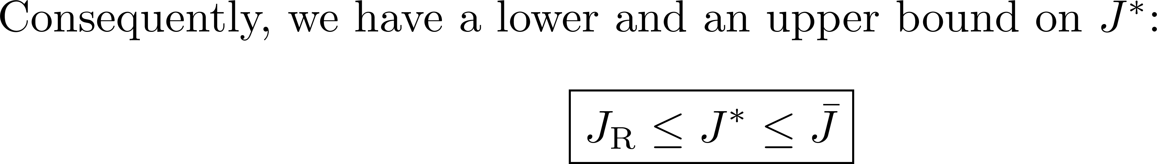
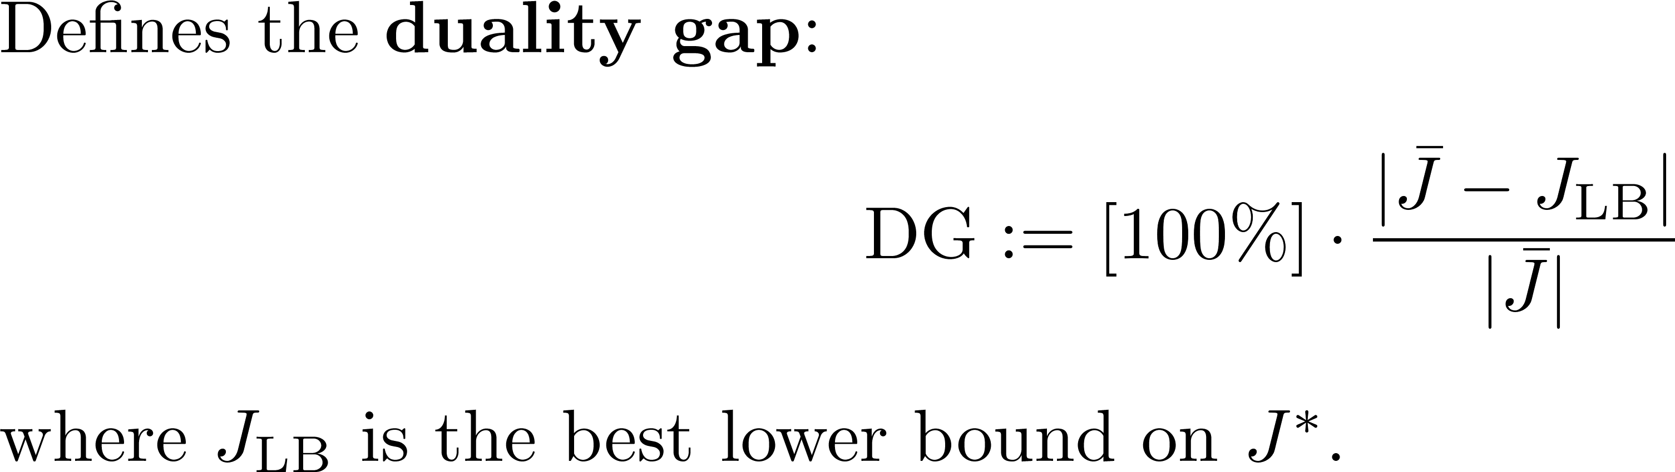
Implicit enumeration: Utilize solution bounds

Slide 7
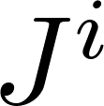
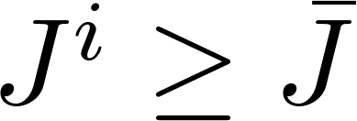
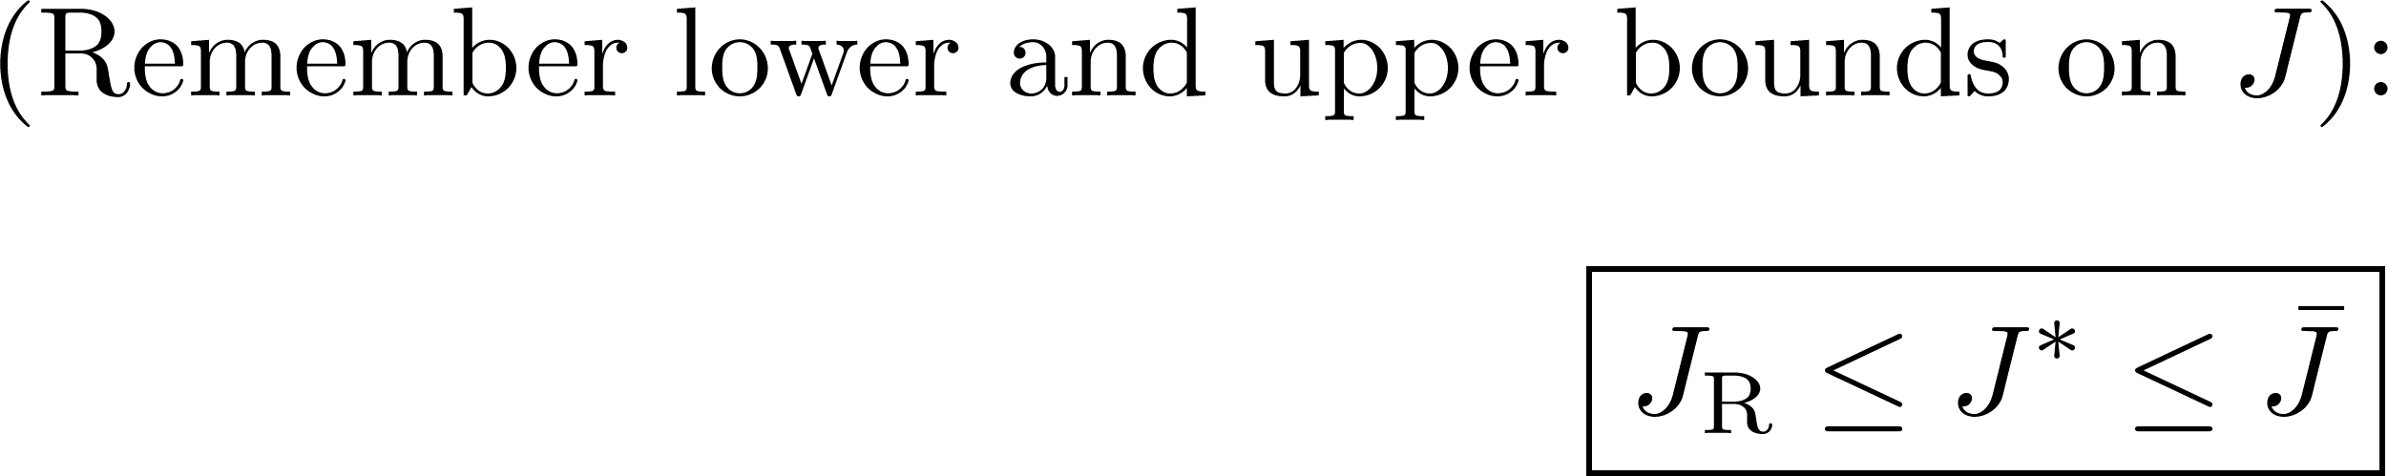
Pruning (= beskjæring av tre)
Utilize convexity of the LP relaxations to prune the enumeration tree.
Pruning by optimality : A solution is integer feasible; the solution cannot be improved by further decomposing the formulation and adding bounds.
Pruning by bound: A solution in a node i is worse than the best known upper bound, i.e.
Pruning by infeasibility : A solution is (LP) infeasible.
Notes:
Husk: konvekst problem, hvis integer feasible, kan ikke finne en bedre integer feasible løsning lengre ned i treet.
Husk: children node kan ikke være bedre enn foreldrenoden.

Slide 8
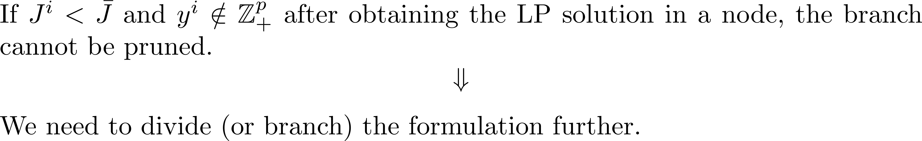
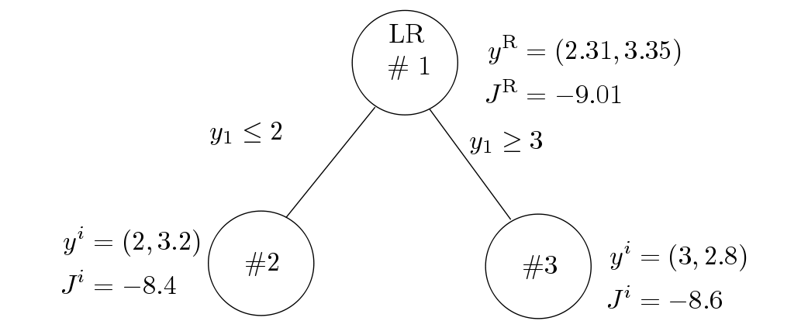
Branching: choosing a fractional variable
Which variable to choose?
Branching rules
Most fractional variable: branch on variable with fractional part closest to 0.5.
Strong branching: tentative branch on each fractional variable (by a few iterations of the dual simplex) to check progress before actual branching is performed.
Pseudocost branching: keep track of success variables already branched on.
Branching priorities.

Slide 9
Node selection
Each time a branch cannot be pruned, two new children-nodes are created.
Node selection rules concerns which node (and hence which LP) to solve next:
Depth-first search.
Breath-first search.
Best-bound search.
Combinations.

Slide 10
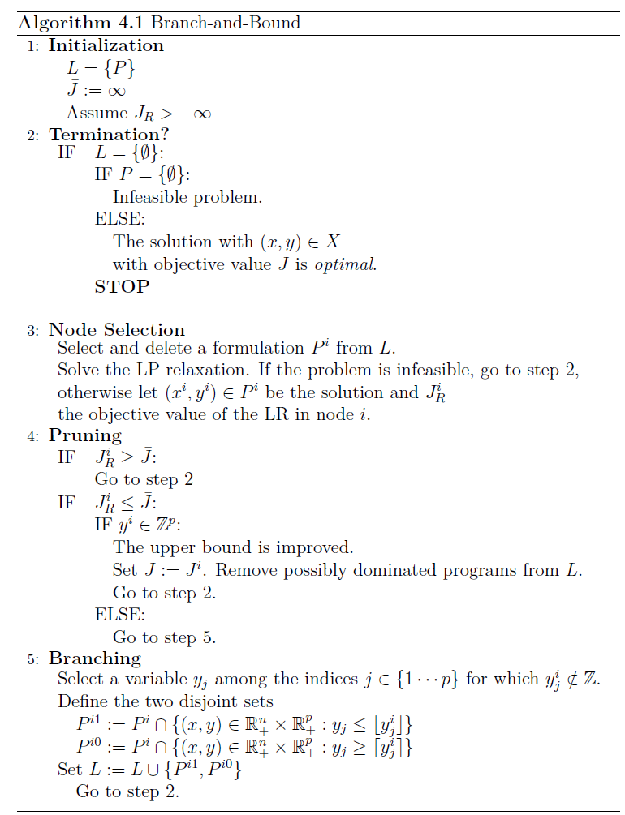
L is a list of with the nodes
Initialize upper bound.
Assume LP is bounded
Solve and check LP relaxation
in root node
Select node a solve new LP
with added branching constraint
Check if solution can be pruned.
Removed nodes from L where the
solution is dominated by the best
lower bound
Choose branching variable,
add nodes to the list L of
unsolved nodes

Slide 11

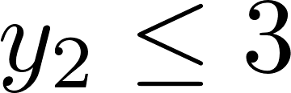
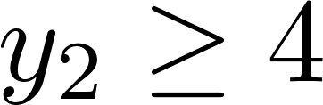
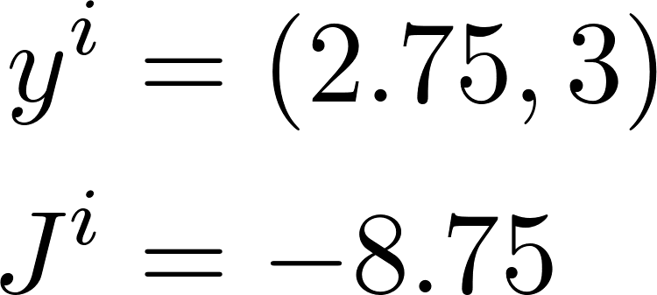
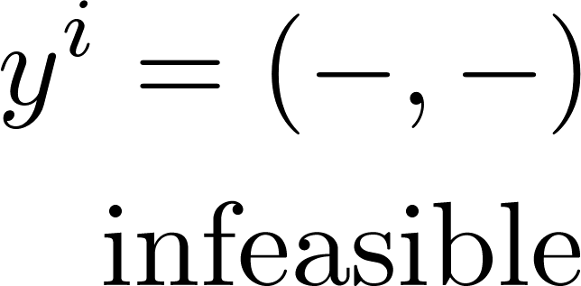
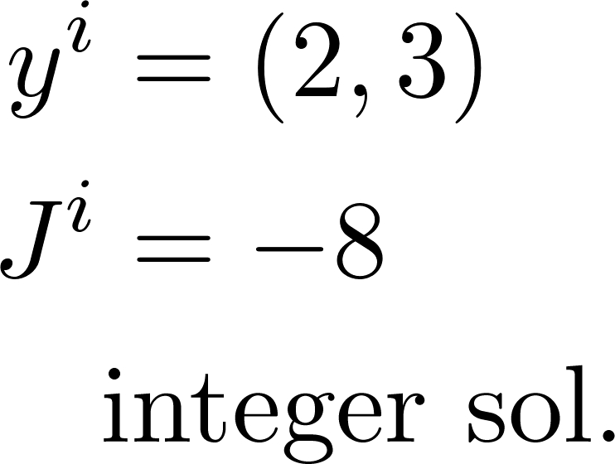
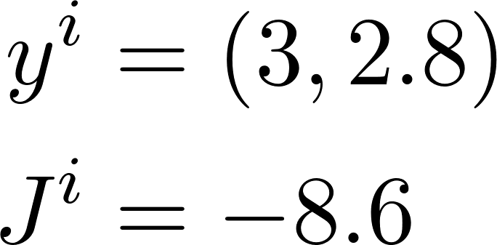


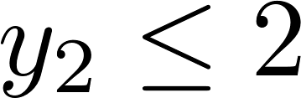
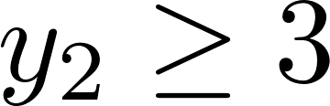
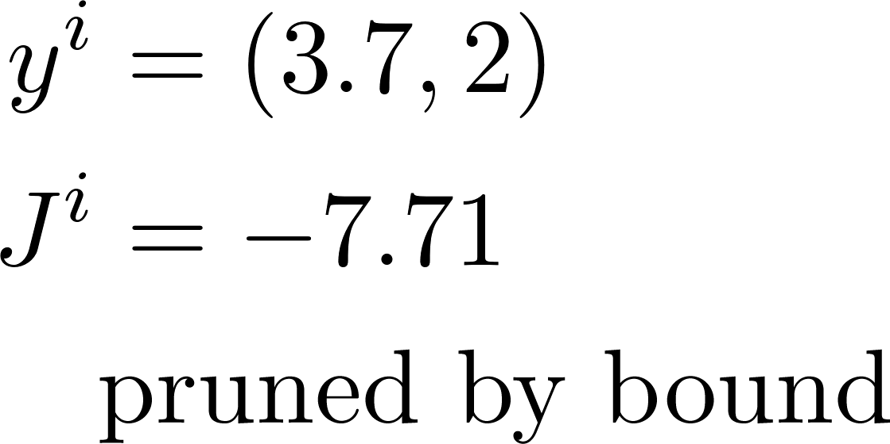


Earlier IP example
Branching rule: most fractional
Node selection rule: best-bound
s
s
s
s
s
IP:
s
s

Slide 12



Software
Optimization modeling languages:
Matlab through YALMIP
GAMS: Generalized Algebraic Modeling System
AMPL: A mathematical programming language
MILP software:
CPLEX
Gurobi
Xpress-MP

Slide 13
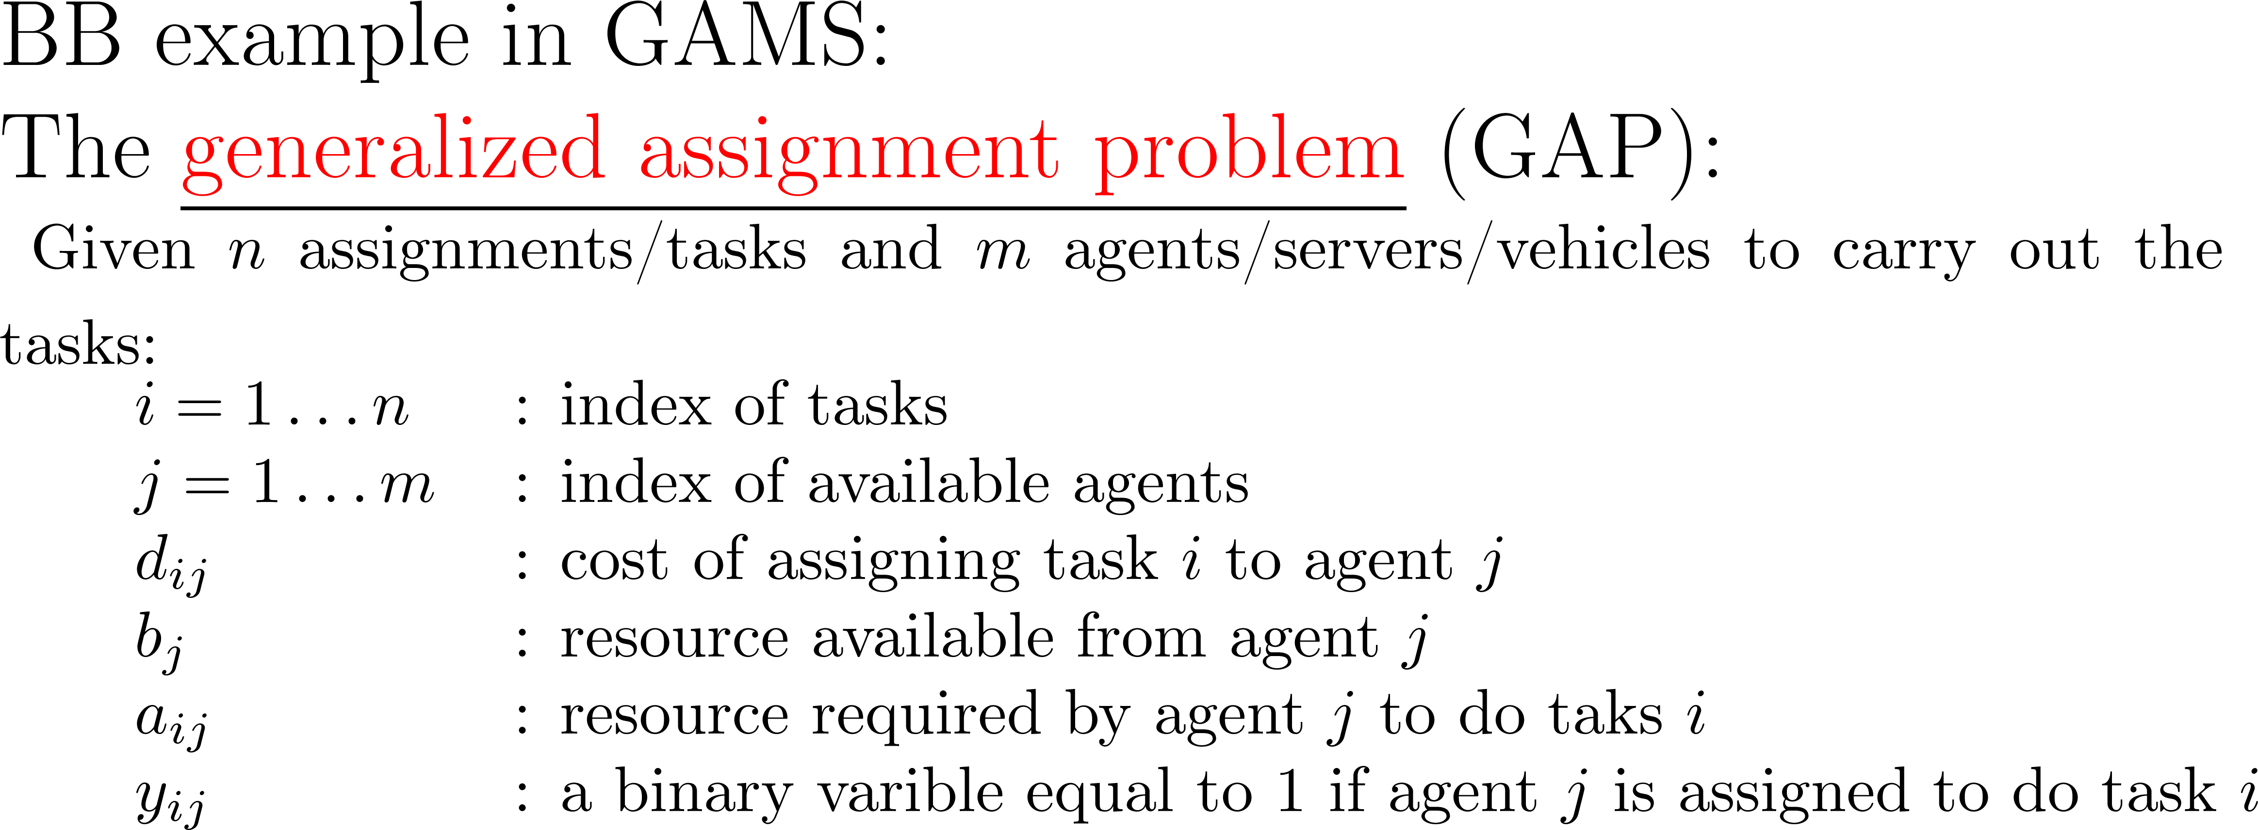
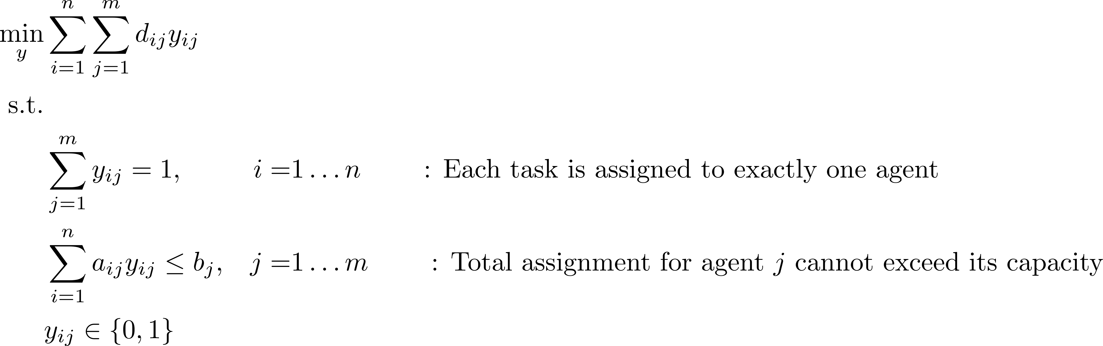

Slide 14
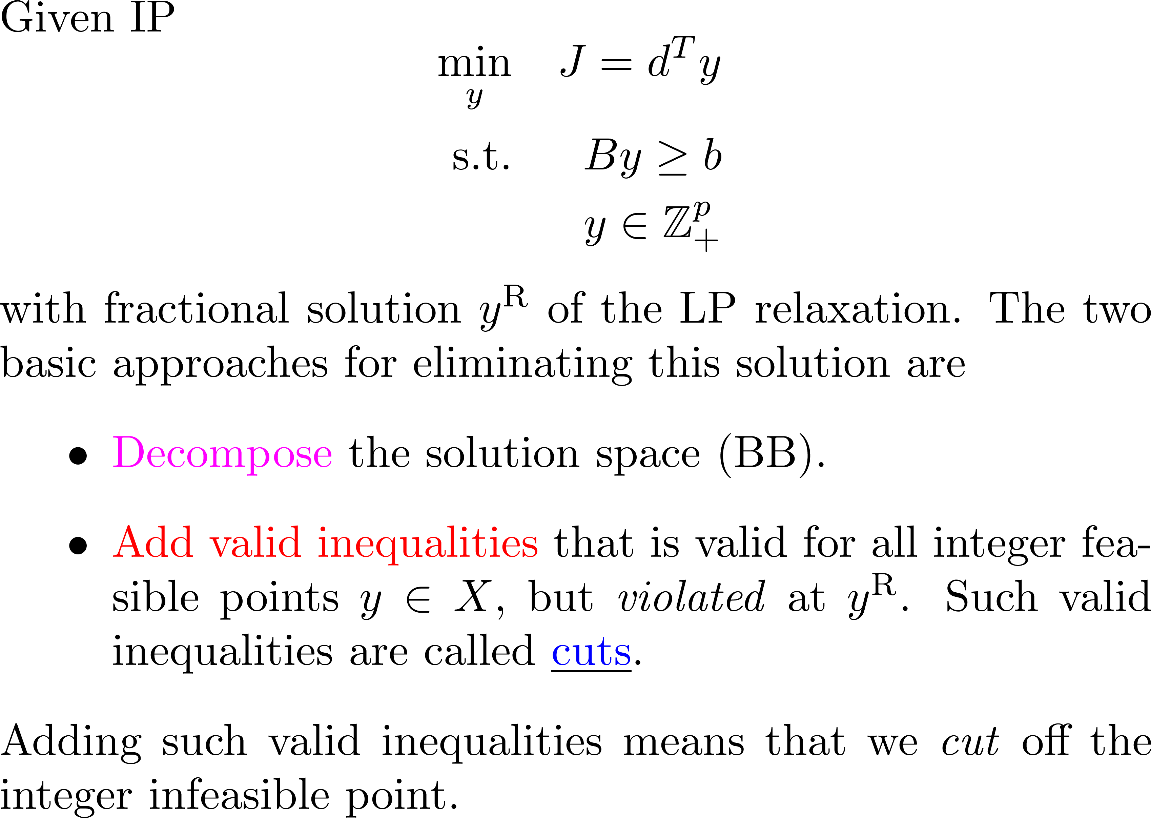
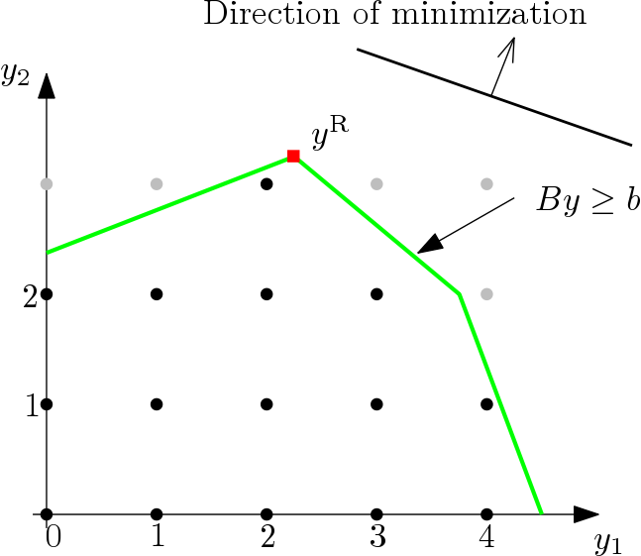
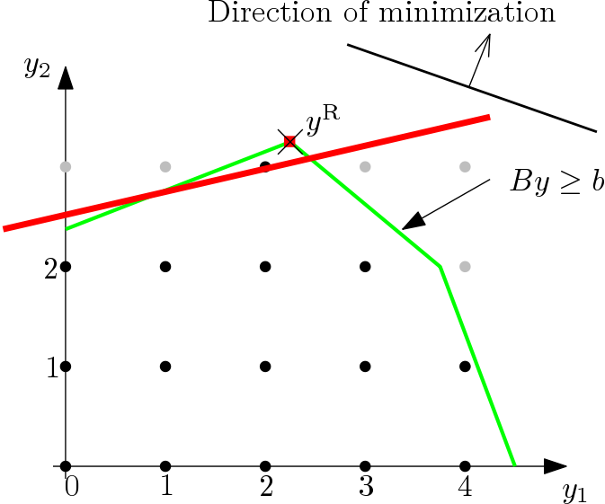
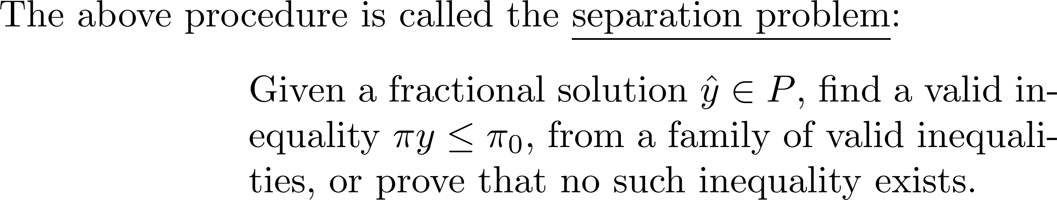
Recall the LP relaxation:
Notes:
Check first: is y in conv(X)?
If not, find a cut.

Slide 15
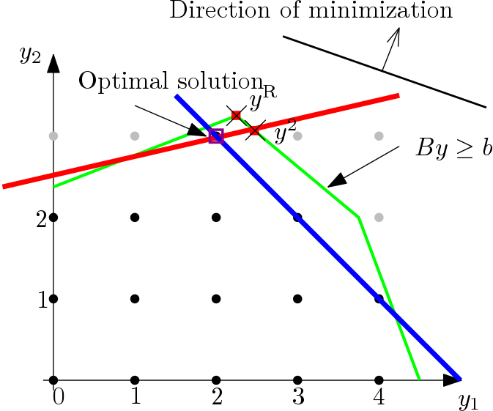
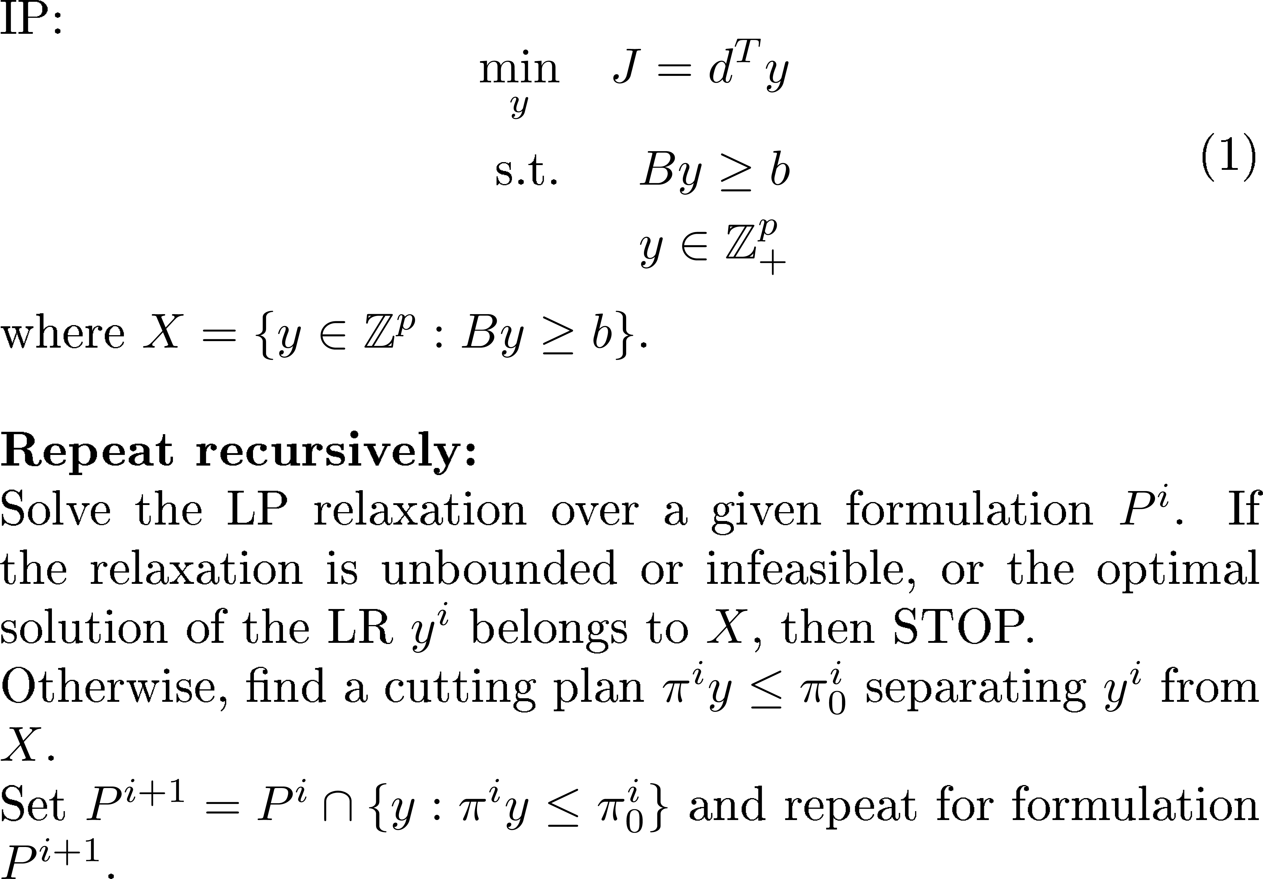

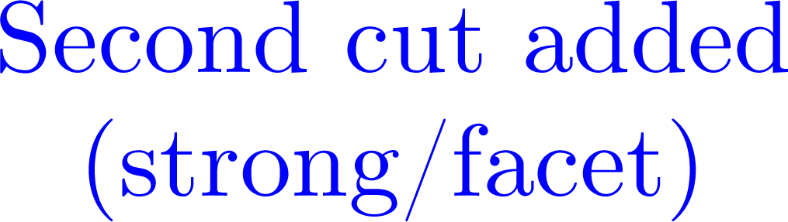
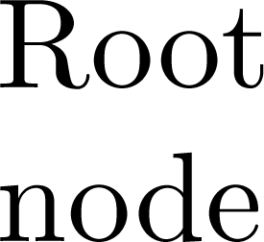
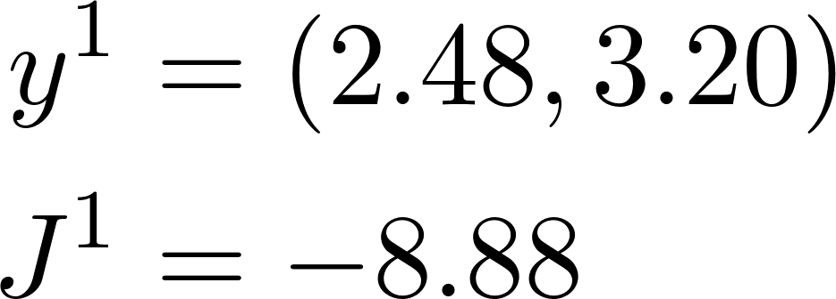

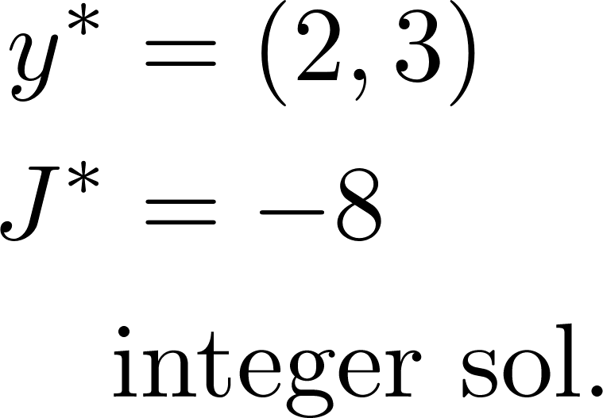
The Cutting-plane algorithm
s
Notes:
The Cutting-plane algortihm er også omtalt som Gomorys CP algortime. Gomorys CP er kun et spesialtilfelle av den mer generelle CP, hvor algoritmen baserer seg på å bruke optimal basis av LP relaksering til iterativt å genere Chvatal-Gomory cutting planes (se side 124 og Th 8.4 side 120 i Wolsey IP bok.)

Slide 16
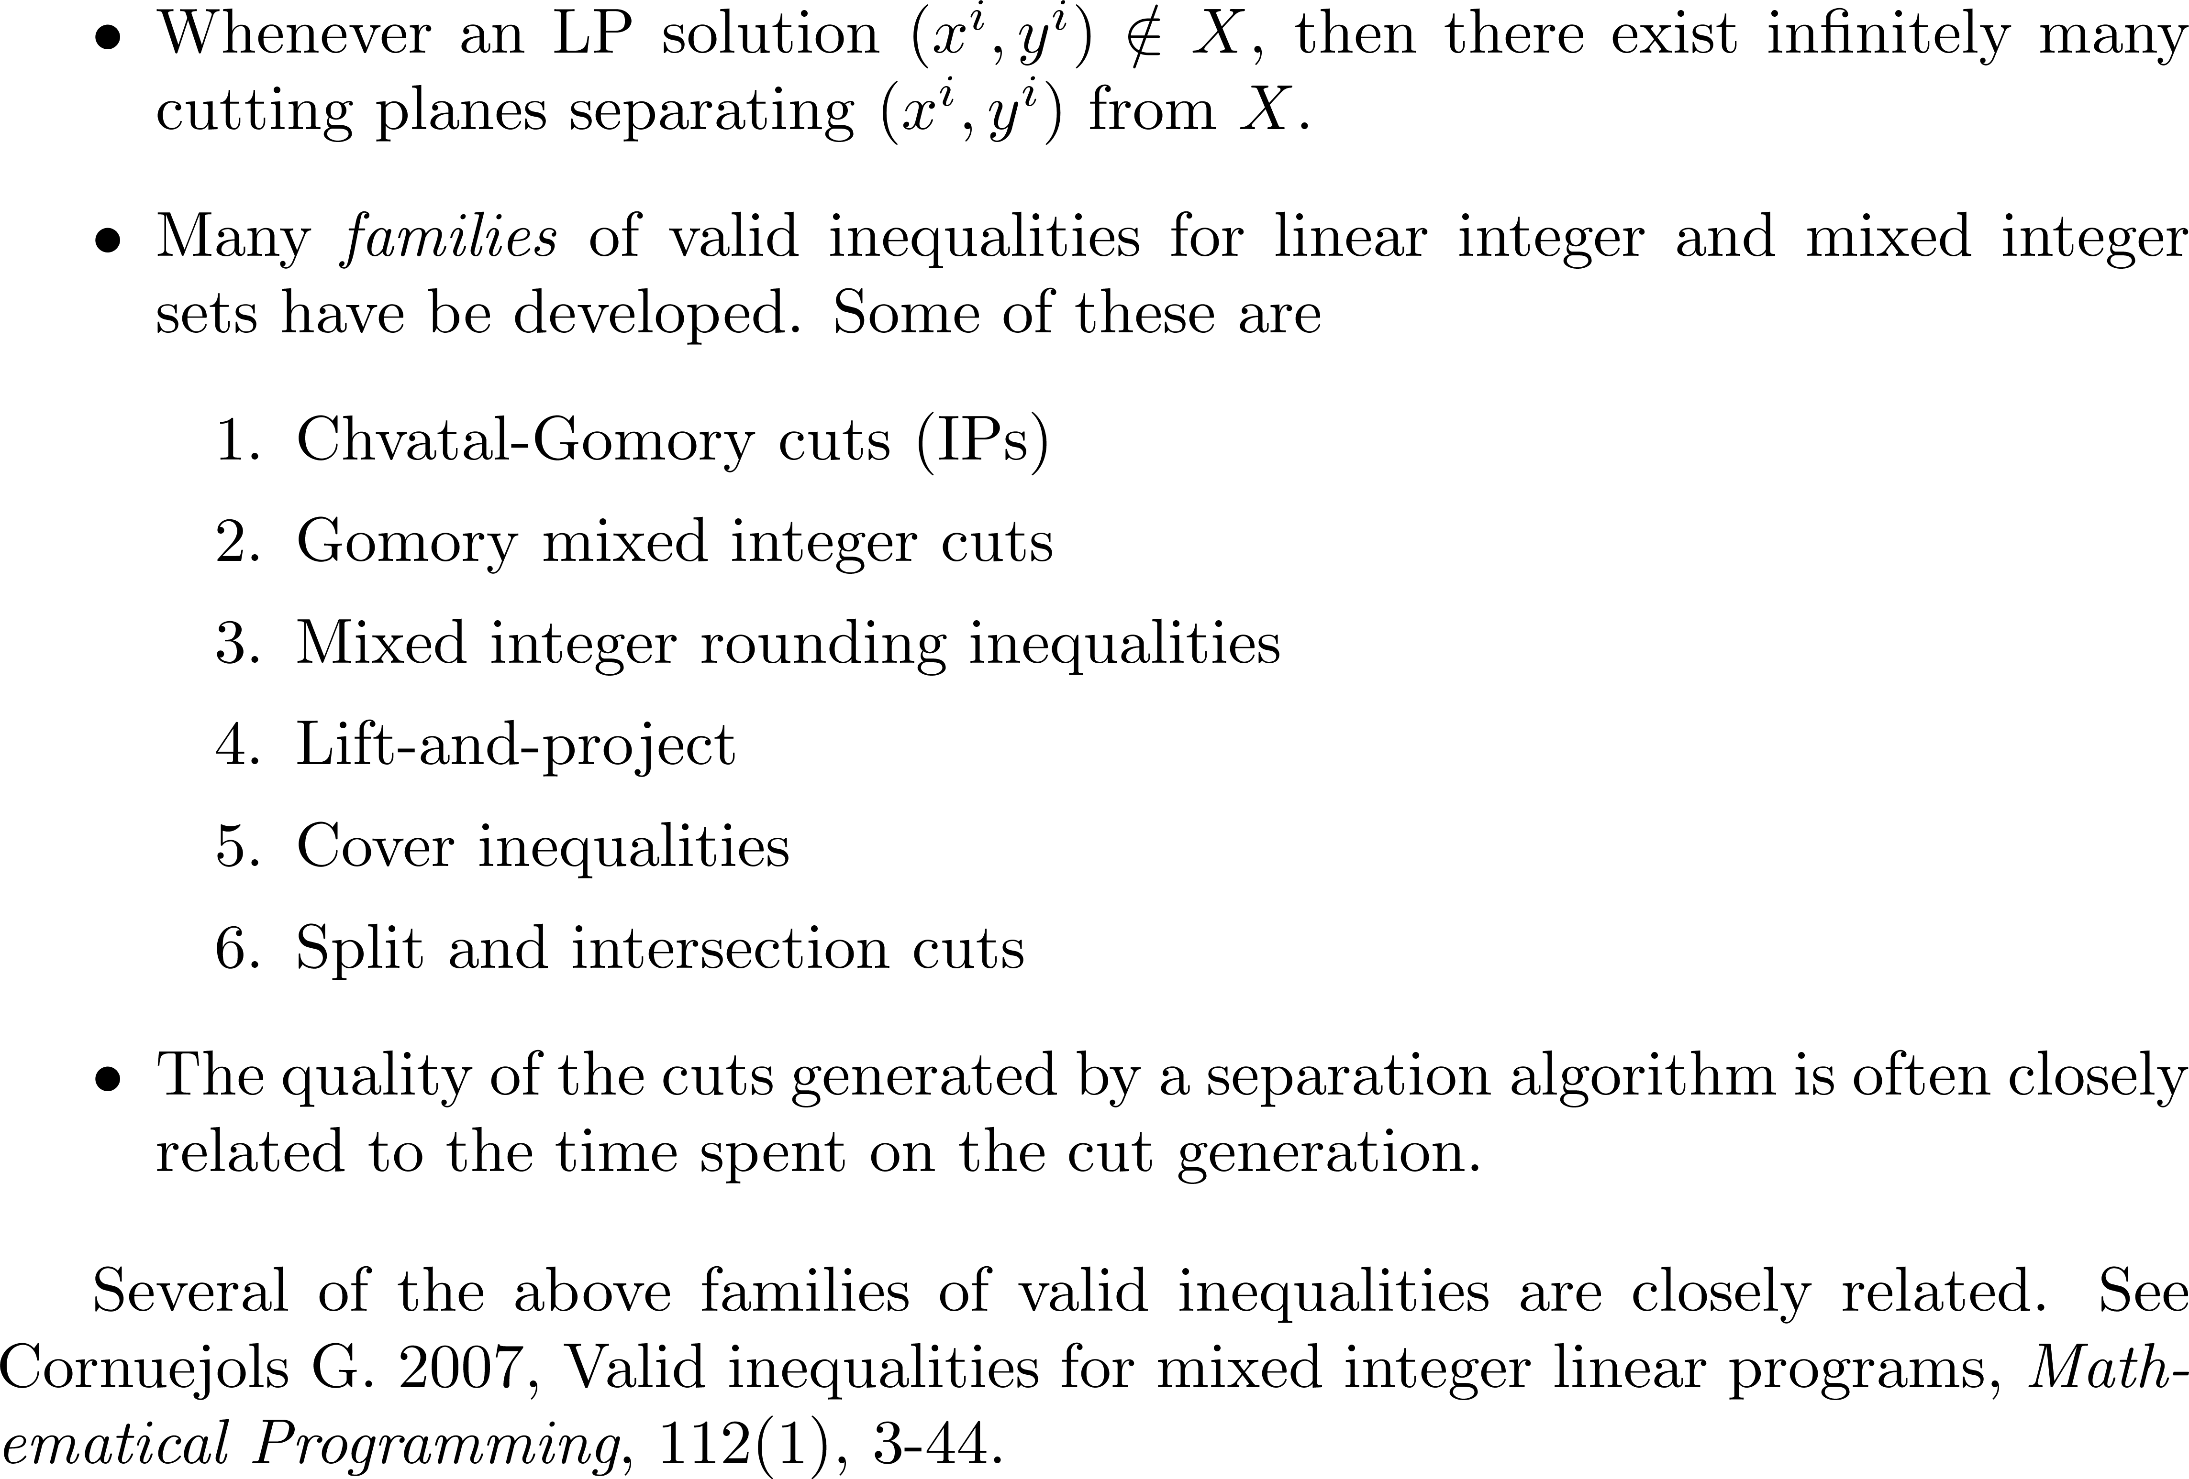
Generating valid inequalities

Slide 17
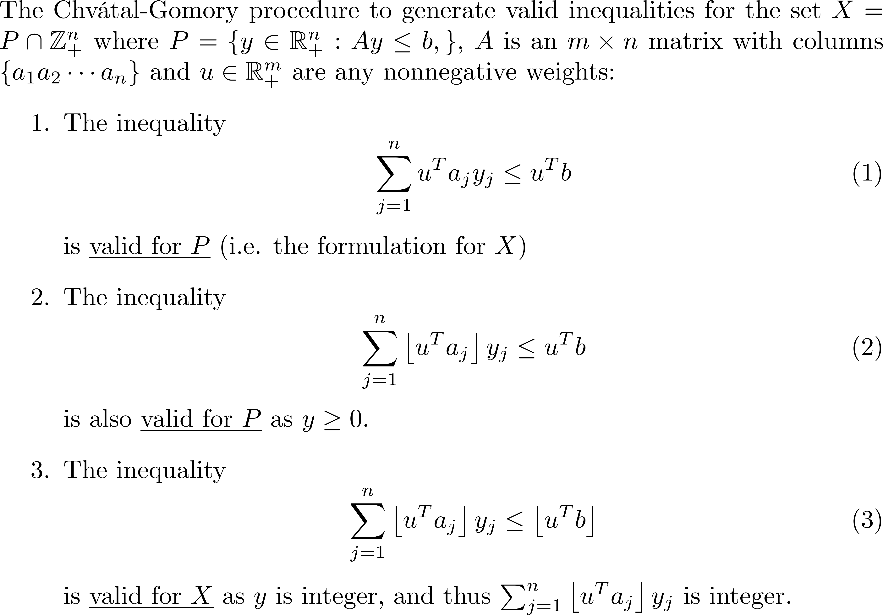
Example on cut generation:
Chvátal-Gomory valid inequalities

Slide 18


Branch-and-cut

Slide 19

Earlier IP example: Branch-and-Cut
Branching rule: most fractional
Node selection rule: best-bound
s
s
s
IP:

Slide 20
The GAP problem in GAMS with Branch and Cut

Slide 21




Choice of LP algorithm in Branch and Bound
Very important for the numerical efficiency of branch-and-bound methods.
Re-use optimal basis from one node to the next.
s
s
s

Slide 22

Solution of large-scale MILPs
Important aspects of the branch-and-cut algorithm:
Presolve routines
Parallelization of branch-and-bound tree
Efficiency of LP algorithm
Utilize structures in problem:
Decomposition algorithms
Apply heuristics to generate a
feasible solution

Slide 23



MINLP: challenges

Slide 24




MINLP: solution approaches
Source: ZIB Berlin

Slide 25
Conclusions
Branch-and-bound defines the basis for all modern MILP codes.
Pure cutting-plane approaches are ineffective for large MILPs.
BB is very efficient when integrated with advanced cut-generation, leading to branch-and-cut methods.
Solving large-scale MINLPs are significantly more difficult than MILPs.

